Slide 1

Friday, October 26, 2012
TISK Problems:
Give an example of an experiment, an event for that experiment, and an outcome for that event.
Simplify: $3m−8p−(−2p−7m)$
Evaluate: $\frac{3}{5}\left(\frac{15}{21}\right)−\frac{3}{14}$
There will be NO Mental Math today.
Homework:
Permutations Word Problems worksheet

Slide 2
Homework Check
24
120
2
5,040
720
3,628,800
40,320
720
3
12
1
360
120
504
306
360,360

Slide 3
Graded Work
Your class’s average on this quiz was…
1st Period: 80.4%
2nd Period: 82.9%
6th Period: 73.5%
New!
From now on, if you get your parents to sign your graded test or quiz within a week, you will receive an addition 2 bonus points.
If you earned less than a C on a test or quiz you are REQUIRED to get it signed. (You still get the 2 bonus points for a signature.)
If you don’t get it signed, an e-mail to your parents will be sent letting them know you didn’t pass that quiz or test!

Slide 4
Word Problems
How do we decide when it is appropriate to use a permutation?
A permutation is when order is important.

Slide 5
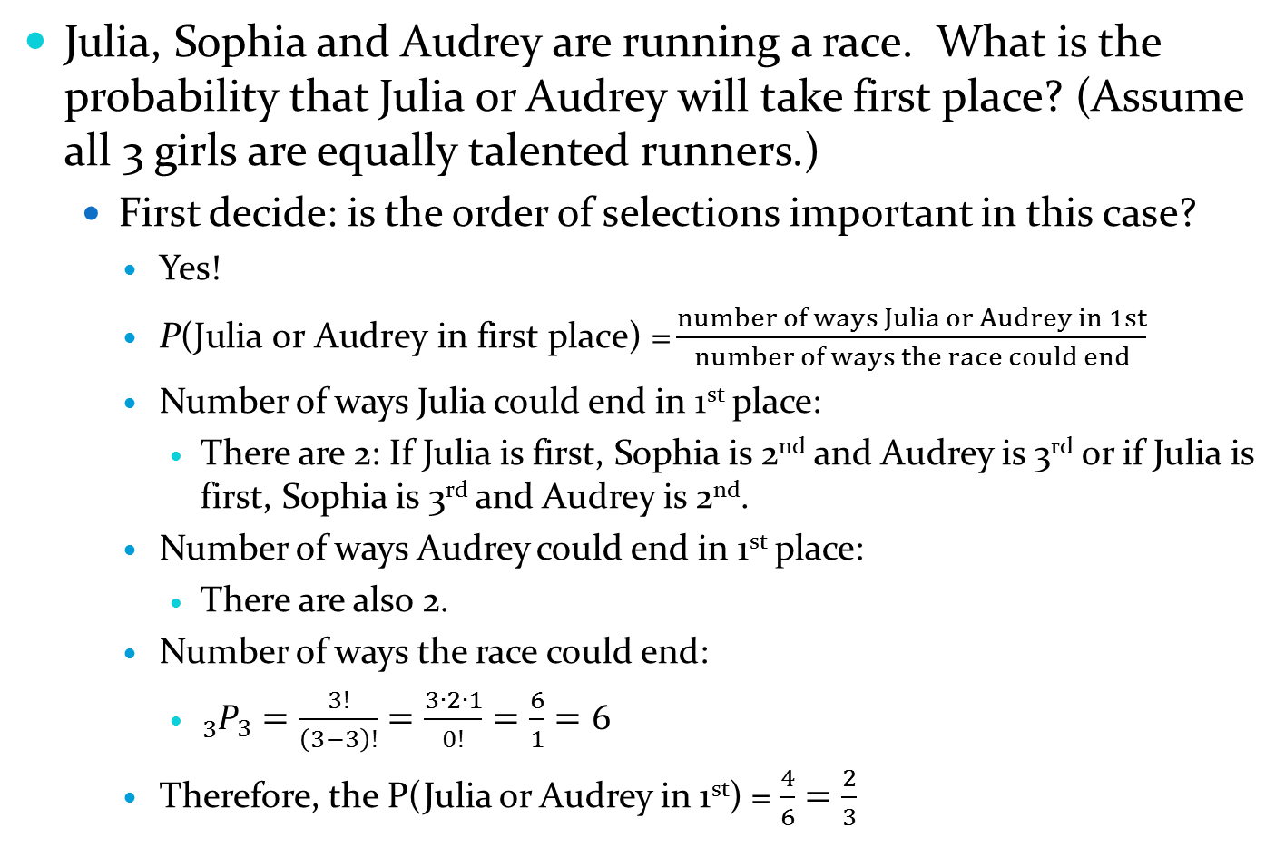
Word Problems
Julia, Sophia and Audrey are running a race. What is the probability that Julia or Audrey will take first place? (Assume all 3 girls are equally talented runners.)
First decide: is the order of selections important in this case?
Yes!
$\text{P}\text{(}\text{Julia} \text{or} \text{Audrey} \text{in} \text{first} \text{place}\text{) =}\frac{number of ways Julia or Audrey in 1st}{number of ways the race could end}$
Number of ways Julia could end in 1st place:
There are 2: If Julia is first, Sophia is 2nd and Audrey is 3rd or if Julia is first, Sophia is 3rd and Audrey is 2nd.
Number of ways Audrey could end in 1st place:
There are also 2.
Number of ways the race could end:
${}_{3}^{}{P_{3}=\frac{3!}{\left(3−3\right)!}=\frac{3∙2∙1}{0!}}=\frac{6}{1}=6$
Therefore, the P(Julia or Audrey in 1st) = $\frac{4}{6}=\frac{2}{3}$

Slide 6

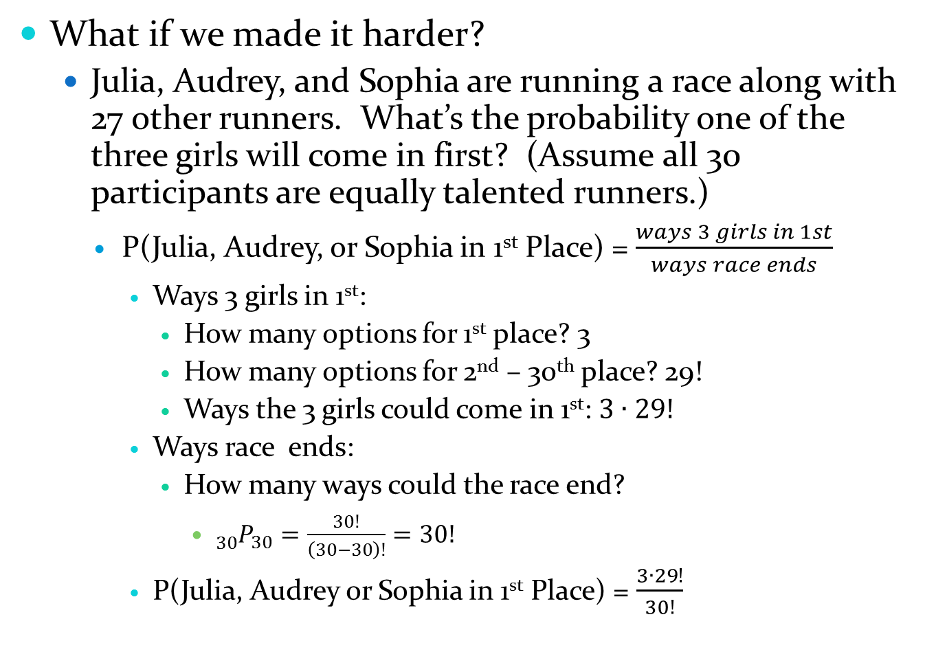
Word Problems
What if we made it harder?
Julia, Audrey, and Sophia are running a race along with 27 other runners. What’s the probability one of the three girls will come in first? (Assume all 30 participants are equally talented runners.)
P(Julia, Audrey, or Sophia in 1st Place) = $\frac{ways 3 girls in 1st}{ways race ends}$
Ways 3 girls in 1st:
How many options for 1st place? 3
How many options for 2nd – 30th place? 29!
Ways the 3 girls could come in 1st: $3∙29!$
Ways race ends:
How many ways could the race end?
${}_{30}^{}{P_{30}=\frac{30!}{\left(30−30\right)!}=30!}$
P(Julia, Audrey or Sophia in 1st Place) = $\frac{3∙29!}{30!}$
$$=\frac{3}{30}=\frac{1}{10}$$

Slide 7
Word Problems
Miss Wiltjer decides to award 5 bonus points to the first three students to walk into class that day. How many different ways are there for her to award the points?
Is order important?
No. If Alyssa, Parker, and Brenna walk in first that would be the same as if Parker, then Alyssa, then Brenna walk in.
Not a permutation!

Slide 8

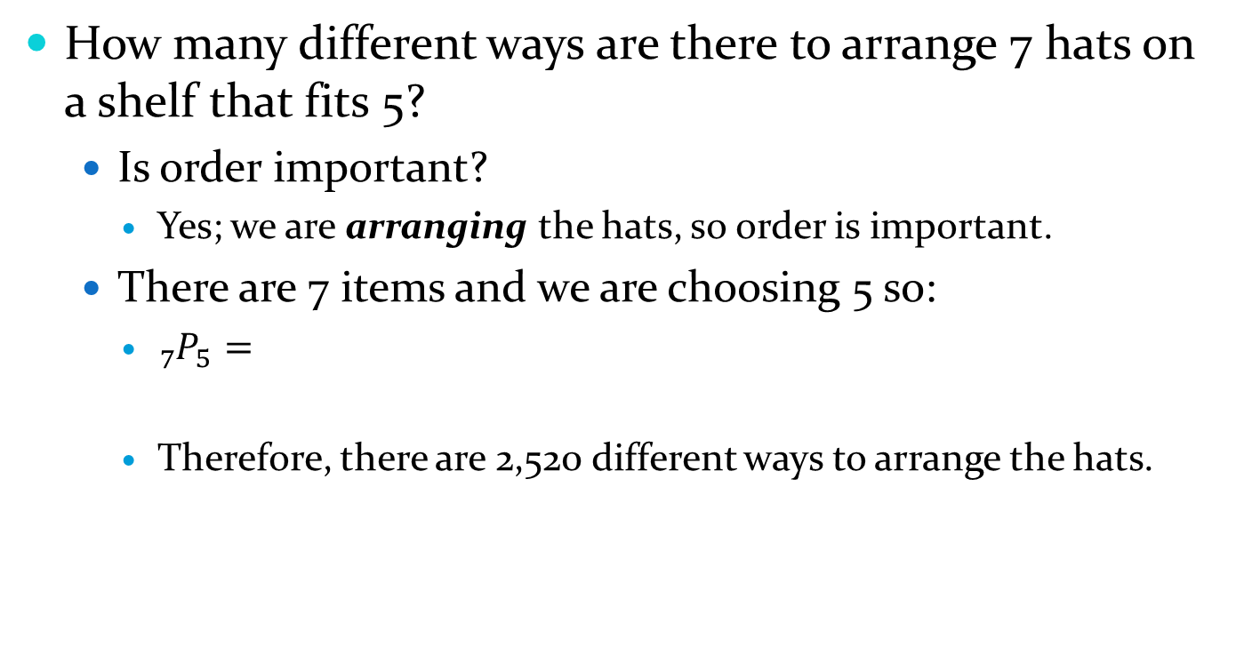



Word Problems
How many different ways are there to arrange 7 hats on a shelf that fits 5?
Is order important?
Yes; we are arranging the hats, so order is important.
There are 7 items and we are choosing 5 so:
${}_{7}^{}{P_{5}=}$
Therefore, there are 2,520 different ways to arrange the hats.
$$\frac{7!}{\left(7−5\right)!}$$
$$=\frac{7!}{2!}$$
$$=7∙6∙5∙4∙3$$
$$=2,520$$

Slide 9
Word Problems
Stephen has a bag of marbles that contains 6 red, 8 yellow, 7 purple, and 5 blue marbles. What is the probability that he draws at least one of each color if he only draws 4 marbles?
Is order important?
No! If he draws a purple, a blue, a yellow THEN a red, it would be the same as if he drew a blue, a yellow, a purple then a red.
Not a permutation!

